Slide 1
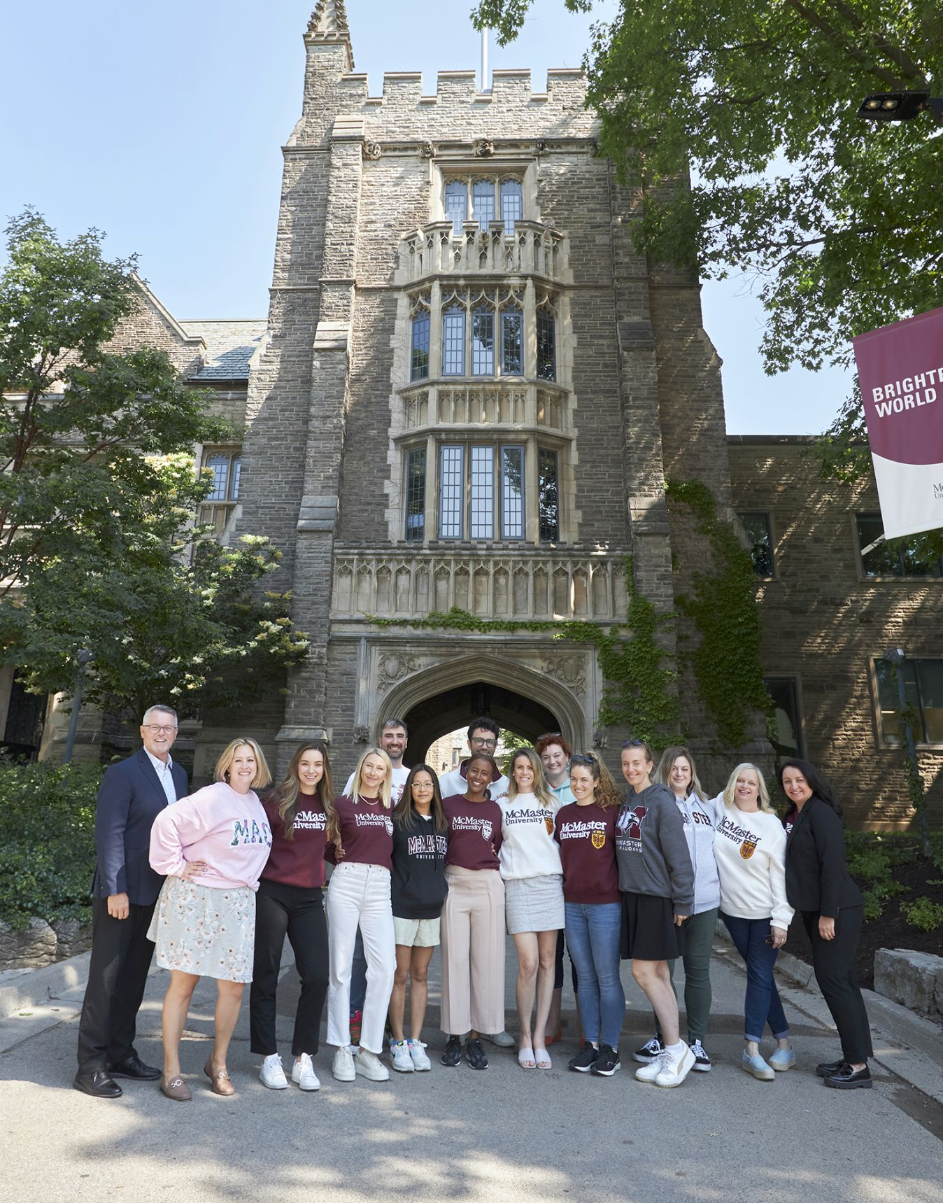

Take Your Career to the Next Level

Slide 2
Table of Contents
1
Welcome and Introduction
2
McMaster University MCM Program Overview
3
Admission Information
4
The Value of Residency
5
Program Information

Slide 3
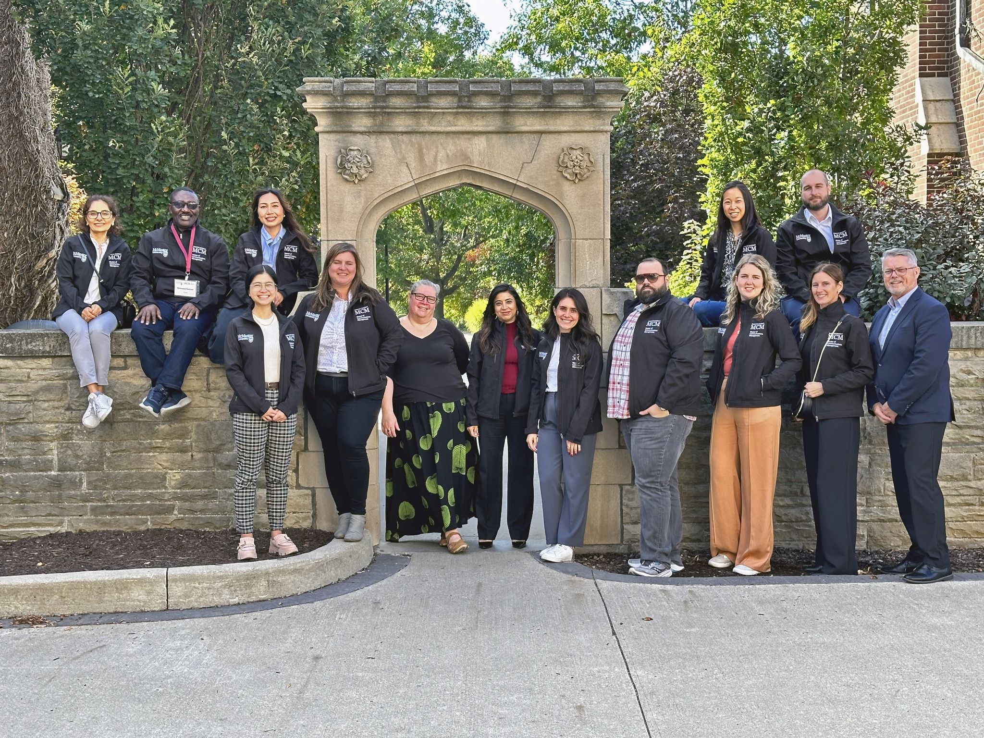
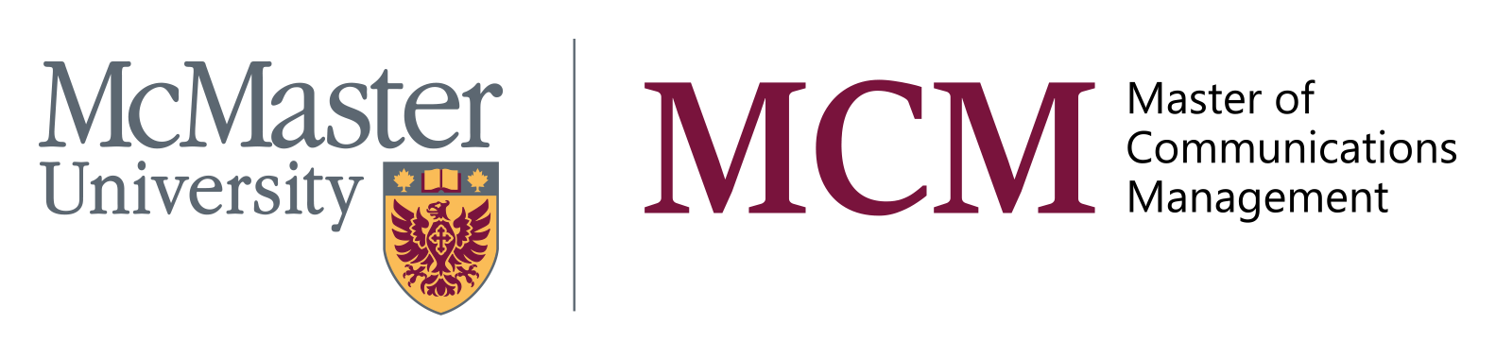
1
Welcome and Introduction

Slide 4
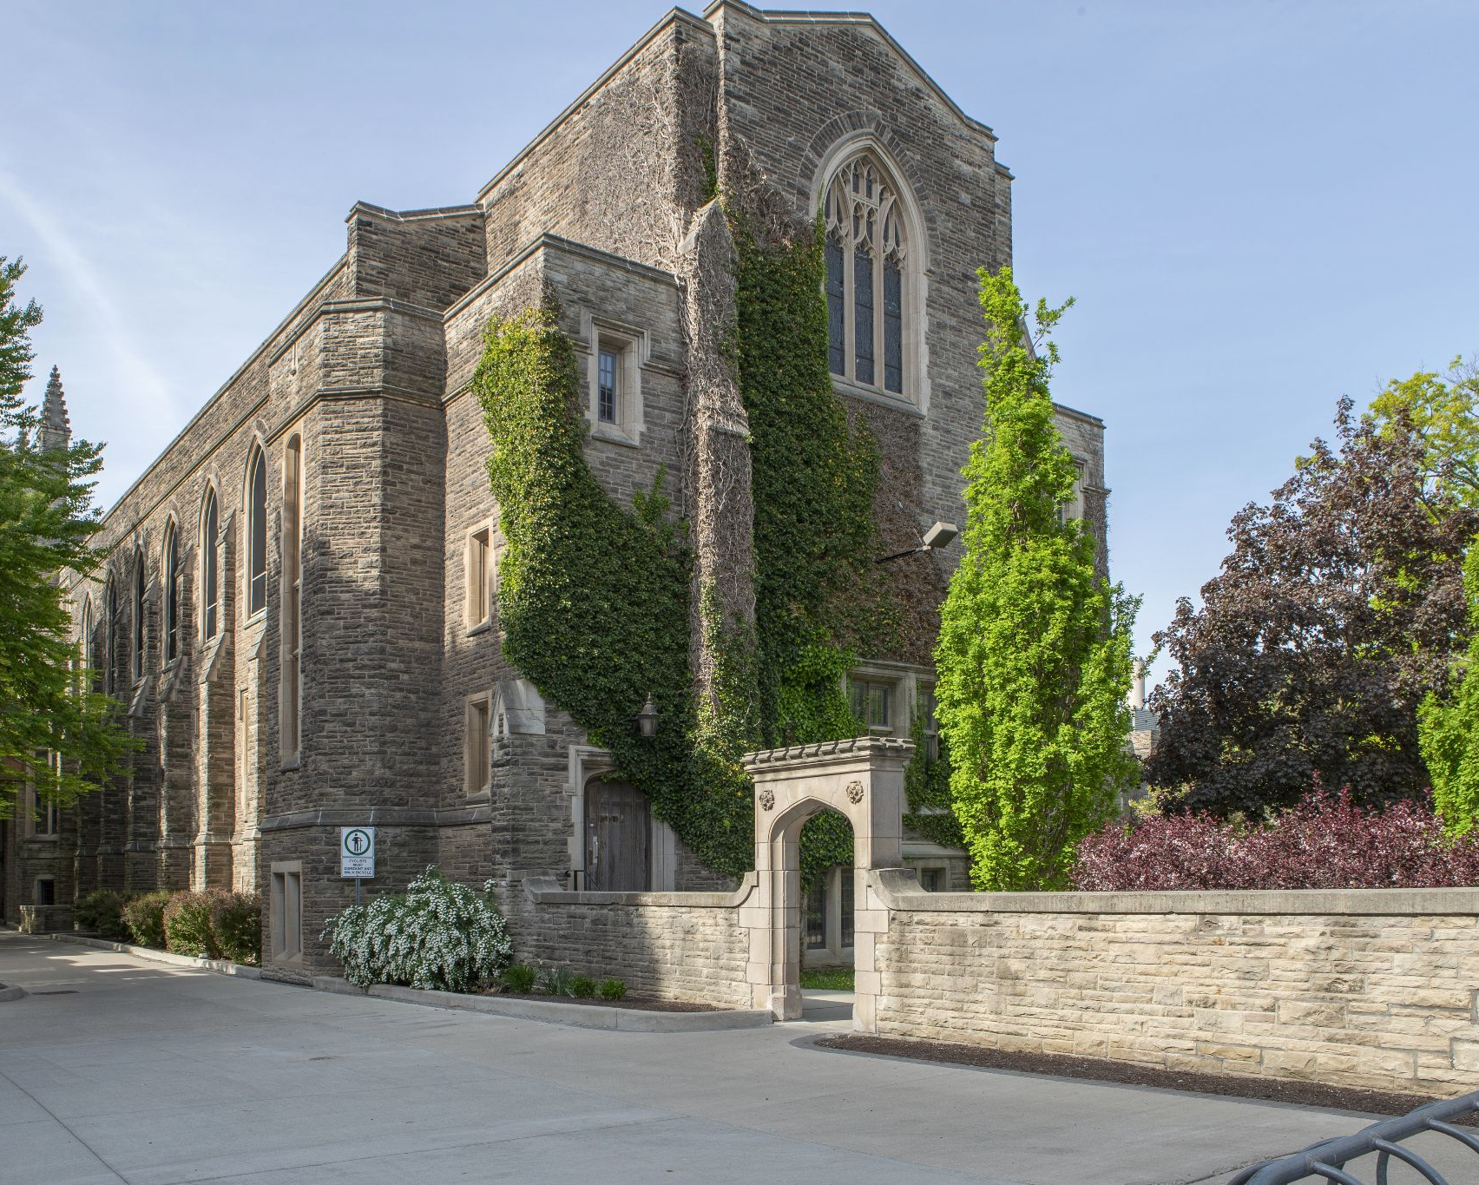
2
McMaster University MCM Program Overview

Slide 5

Program Overview
02
Program Overview
Canada’s premier executive management degree for communications professionals

Slide 6
Program Overview
02
Program Overview
Alumni & Students
Course Structure
Over 250 alumni and students from across Canada and increasingly from around the world
Mix of business, communications, data analytics, and leadership courses
Flexible Delivery
Made for You
Continue to work and learn at the same time
Designed by communications executives
and thought leaders for students of communications management

Slide 7
Our Target Audience
02
Program Overview
Experienced
Career Driven
Academics
Communications professionals with more than three (3) years of experience
Professionals interested in advancing their management careers
Communicators who are interested in pursuing a teaching career in colleges or universities

Slide 8
The Purpose
02
Program Overview
Improvement
Skill-Building
Empowerment
To enhance current professional performance
To develop critical management abilities
To offer opportunity for excellence as a decision- maker and counselor
Accessibility
Innovation
To respond to needs of experienced practitioners who cannot use traditional educational routes to advance careers
To build thought leadership in a growing area of management: communications/marketing

Slide 9
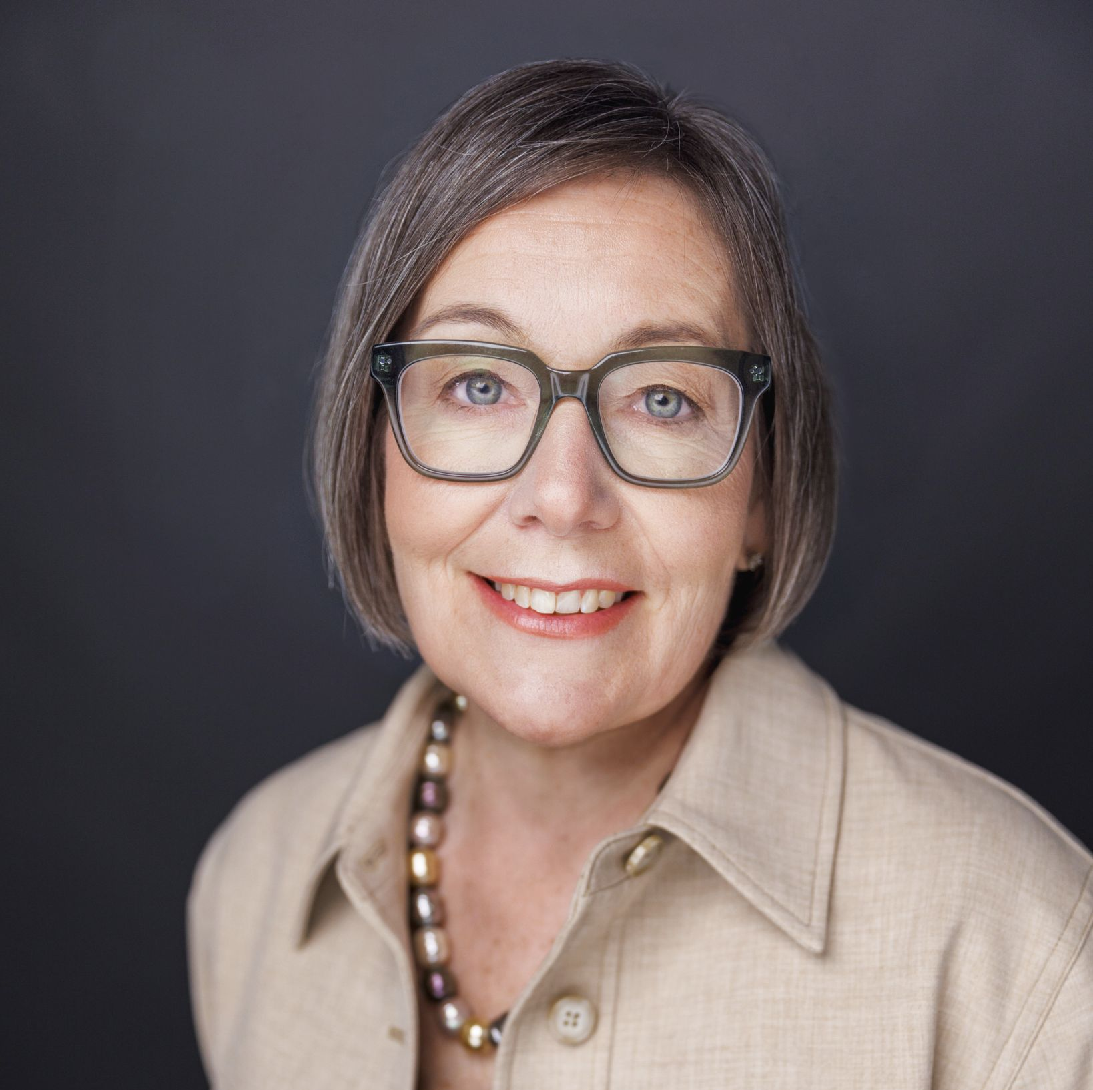
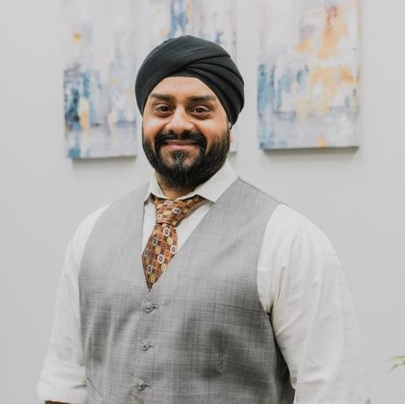
Our Alumni
02
Program Overview
Christine Szustaczek,
MCM, APR
“The MCM program expanded my thinking and gave me foundational knowledge that has helped me become a strategic communications management professional.”
Parm Chohan,
MCM
“The MCM program taught me how to think strategically, and how to speak intelligently and confidently about the work we do as communications professionals.”
Vice-President of Communications
University of Toronto
Owner, Leadership and Personal Growth Coach
Conquer Leadership

Slide 10
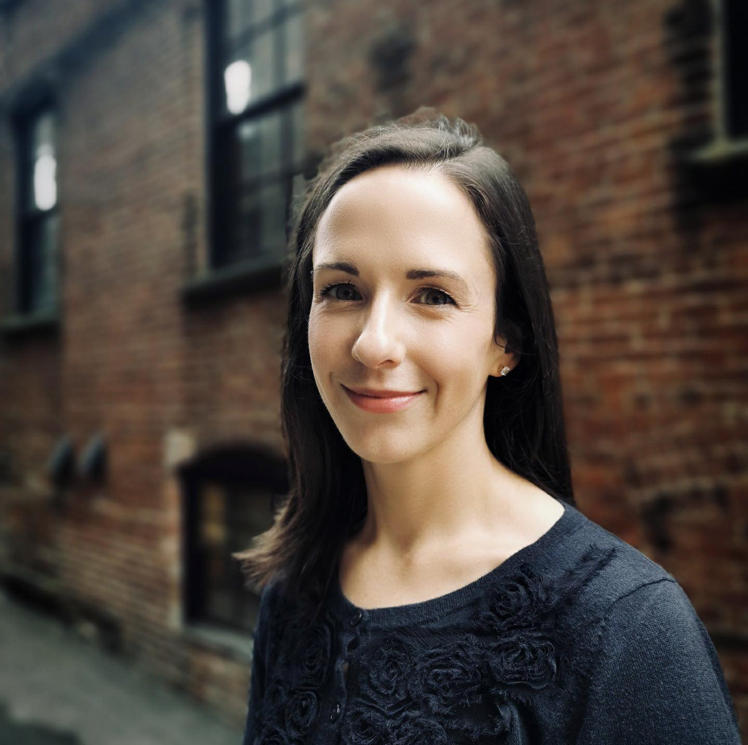
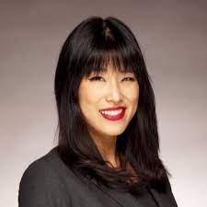
Our Alumni
02
Program Overview
Claire Ryan,
MCM, APR
“Five years after graduating, I now consider the MCM learning journey to be life-long, as I continue to benefit from the expertise and support of my classmates, faculty, and the "MCM Network.”
Rita Chen,
MCM
“The gains I’ve experienced are not only reflected in the progression of my own career but that of my former cohort - all of whom have either advanced or changed their careers since graduating.”
Director of
Public Relations
Cooke Inc.
Director of
Global Outreach
Seneca International

Slide 11
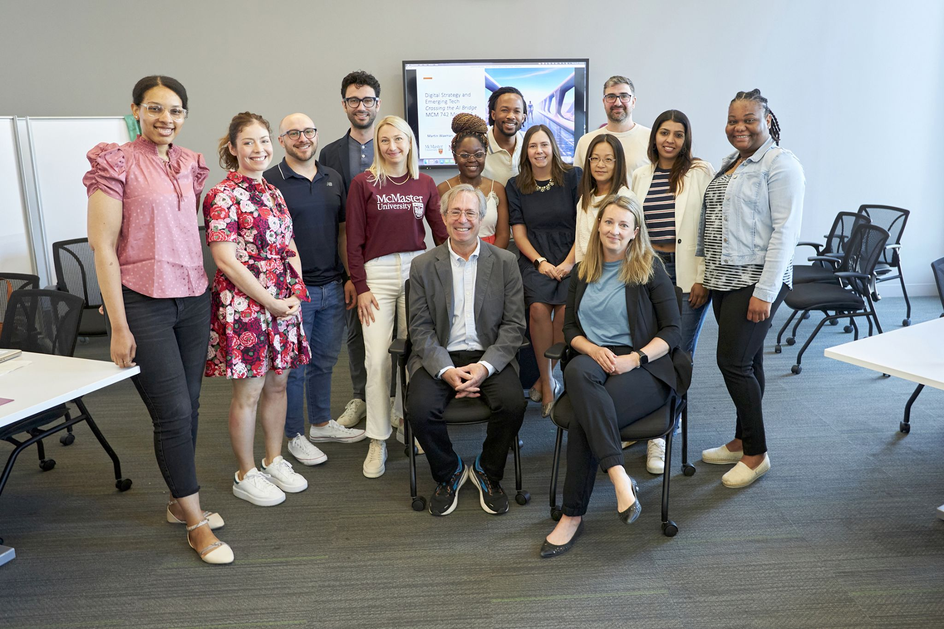
03
Admissions
Information

Slide 12
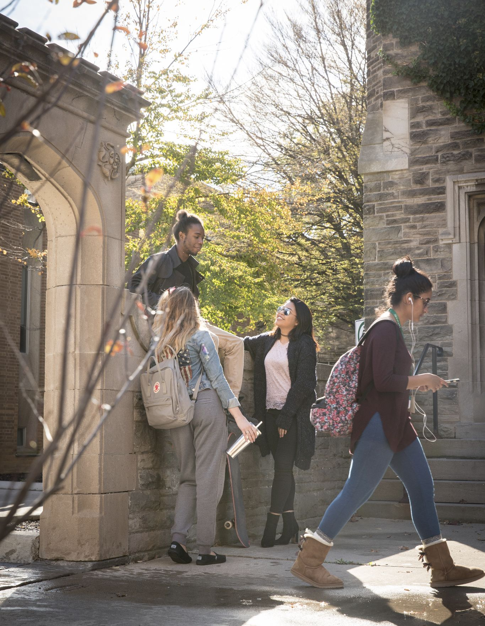
03
Admissions Criteria
Admissions Criteria
Successful applicants will have:
A completed online application
Minimum of three (3) years of full-time work in professional communications
An Honours Bachelor's degree or equivalent professional degree from an accredited university with at least a B+ average.

Slide 13
Admissions Criteria
03
Admissions Criteria
Two letters of recommendation, including one from the current employer. (If the applicant is an independent consultant or counselor, this letter can be from a current client or partner).
A personal essay (typed; maximum 500 words) explaining interest and suitability for the program as well as potential for completing the program.
A portfolio of samples of best work, particularly those which illustrate strategic management ability (e.g. public relations plans; marketing plans; crisis plans).

Slide 14
Admissions Criteria
03
Admissions Criteria
A personal interview with the Academic Director or Admissions Committee, either in person or online.
Prospective applicants who do not meet the normal admission requirements should consult the program Director to discuss how their work experience might be assessed to make up for insufficient standing in their undergraduate degree.
Your current CV.

Slide 15
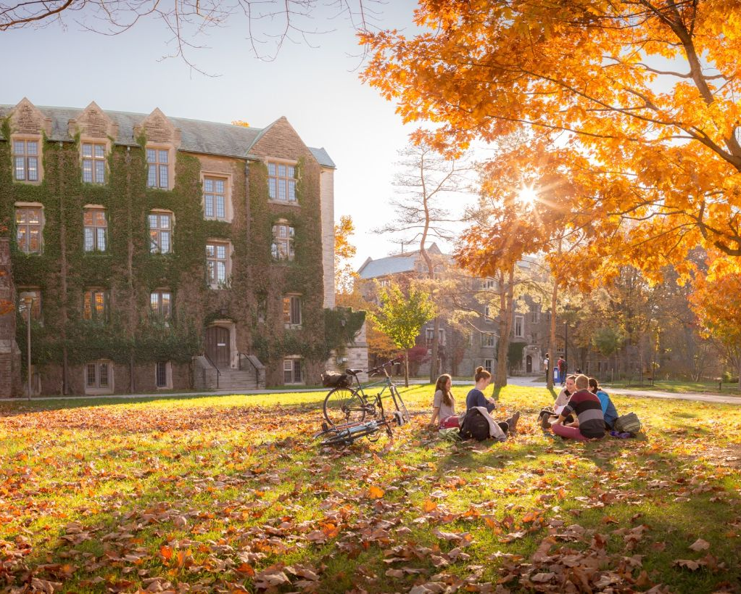
4
The Value
Of Residency
Building Trust, Networking
& Sharing Insights

Slide 16
Executive Education Format
04
Value of Residency
On Campus Residency
Term Schedule
Term
Example
Each term, students must be present on campus for six days of instruction and dialogue with professors and administrators
Fall - (Term 1/4) - (October)
Winter - (Term 2/5) - (February)
Summer - (Term 3/6) - (June)
Term 1: Organizational Public Relations & Financial Accounting
Term 2: Public Relations Research & Managerial Finance
Term 3: Electives (Reputation, Social and Digital Media Management, Negotiation)

Slide 17
Distance Learning
04
Value of Residency
Each professor hosts online sessions following the in-person residency
A series of online discussions posts, assignments/tests and final cumulative report/study will be due during the course of the term.
Each student has access to our MBA Learning Hub and other databases through the McMaster electronic library.
Professors are available via online discussions or email/telephone or in person to discuss assignments and progress in the course.
On average, the number of hours per week required to complete the readings, assignments and participate in the discussions ranges from 10-15 hours.

Slide 18
5
Program
Information

Slide 19

05
Program Information
The Culminating Event
The capstone project course
(worth one course/three credits)
The capstone requires guidance from an advisor of the student’s choice.
We offer a comprehensive capstone research course and hands-on mentorship to help students produce a project that helps them to become a thought leader in their chosen area of research.
Many of the capstone projects are published or form the basis of significant consulting/public speaking or personal career advancement.

Slide 20
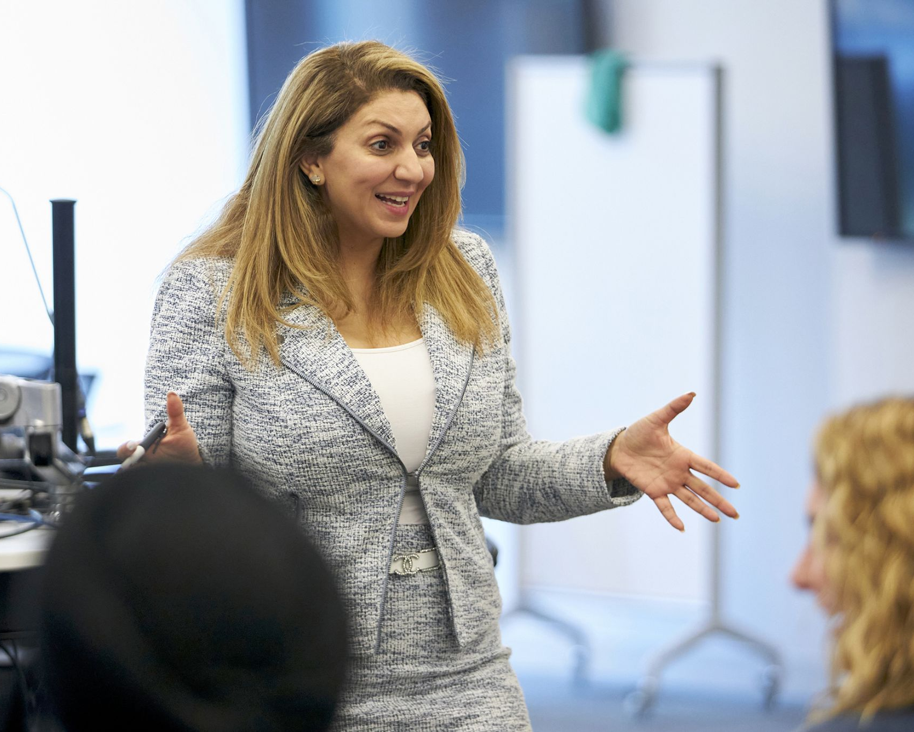
Our
Faculty
Notes:
Management Courses:
Each term, students must be resident on campus (or online) for six days of instruction and dialogue with professors and administrators
Strategic Communications Courses:
Strategic Communications Courses (Organizational Public Relations, Public Relations Research, Applied Ethics and Issues and Crisis Management) will be taught by professors from McMaster and select senior industry experts.
Each course offers Canadian perspectives in a comparative USA and global context.

Slide 21
Potential Electives
05
Program Information
Courses such as:
Negotiations, Reputation Management, Digital and Social Media Management, Leadership Communication.
Taught by McMaster professors or select industry experts.
Students vote on summer electives during the February residency.

Slide 22
Fees and Expenses
05
Program Information
Application:
$110.00 (one-time non-refundable fee), payable online by credit card.
Tuition:
Approximately $4,348.83 (Canadian) and $5,259.24 (International) per 3-credit course – cost per term is $8697.66 and $10518.48 for two courses. The full cost of the program is payable on a course-by-course basis and 12 courses are required to graduate.
Misc. Fees:
$608.00 (Rate varies annually). Please see School of Graduate Studies Calendar, Section 5.
Travel:
Varies with individual. Current program participants come from all over Canada.

Slide 23
Fees and Expenses
05
Program Information
Meals:
Health-conscious meals are provided during the residency (including breakfast, lunch and coffee breaks). Some meals are provided during social events (usually 2 per residency).
Lodging:
Ranging from $99 - $150 per night plus local taxes (at nearby hotels or AirBnBs).
Transport:
$40-45 each way to/from Hamilton International Airport; $80-100 each way from Pearson International Airport.
Parking:
If you have a vehicle, parking is available at $20.00 per day on McMaster campus.

Slide 24
$110,192
$124,893
$119,900
$83,197
$105,000
$99,500
$82,674
$95,300
05
Program Information
Executive Graduate Program Cost Comparison
Schulich/Kellogg Executive MBA
Rotman Executive MBA
Ivey Executive MBA
University of Alberta Executive MBA
Queen’s Smith School of Business E-MBA
McGill Desautels Executive MBA
University of Calgary Haskayne E-MBA
McMaster - DeGroote EMBA
Notes:
Our price: $52,185 (as of 2023-2024)
McMaster University Executive MCM Program

Slide 25
Program Deadline
05
Program Information
New Application Deadline: June 30, 2024
Early Application Review: March 1st, 2024 (deadline for international applicants)
Secondary Application Review: May 1st, 2024
Final Application Review: June 30th, 2024
Apply Now:
Apply now online for 2024 Cohort: mcm.mcmaster.ca
Necessary Application Materials:
Two letters of reference
Academic transcripts from all post-secondary institutions you have attended, even if you did not complete the degree/diploma/certificate
Portfolio and C.V.
500-word personal statement

Slide 26
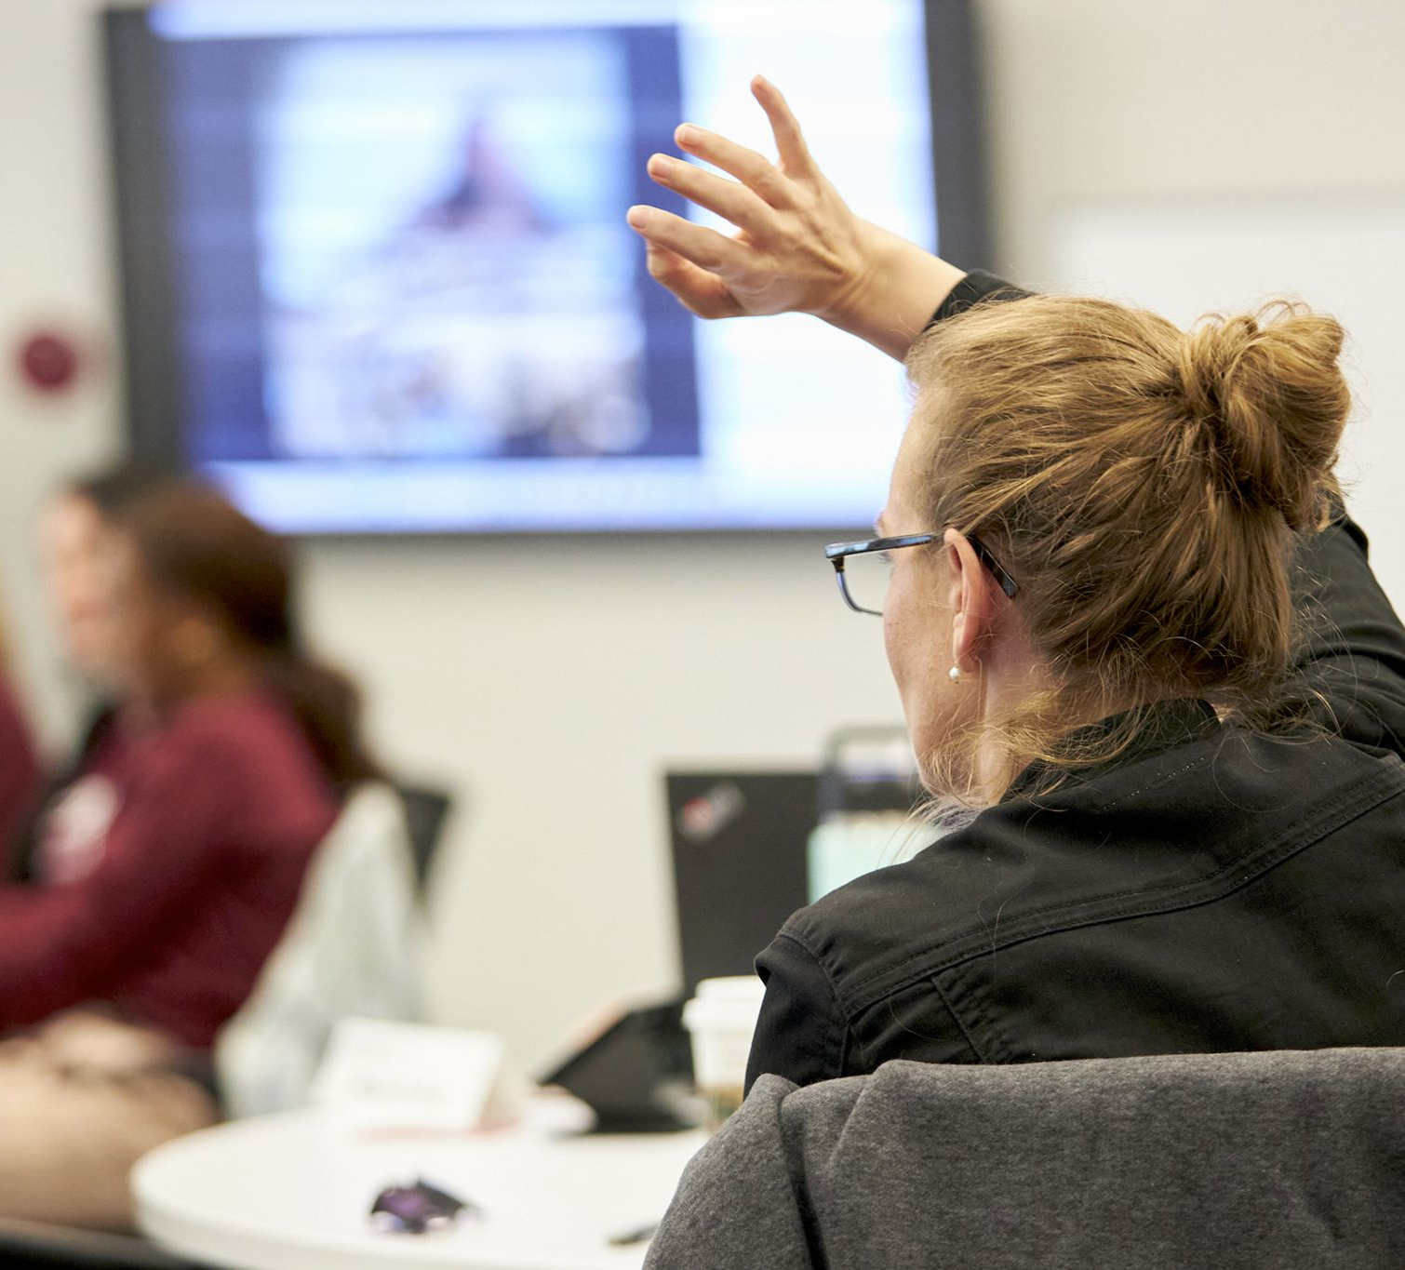
Questions &
Contact Information
Dr. Terry Flynn
Program Director
mcmdir@mcmaster.ca
Kayla Colanardi
Program Assistant
mcmadmin@mcmaster.ca

